Slide 1


Slide 2
Guide
Prof. Kartik Joshi
Team Members
Shashank Gadam (08)
Suraj Panchal (19)
Abhishek Patel (22)
Monil Shah (33)

Slide 3
Project Profile
Project Title | FashFab : Ecommerce website
Description | A clothing and accessories website, where one can stop and shop for their fashion needs.
Tools and Technologies used | PHP Wordpress SQL
Developed By | Shashank Gadam(08) Abhishek Patel(22) Suraj Panchal(19) Monil Shah(33)
Guided by | Prof. Kartik Joshi
Replace with your own text

Slide 4
Index page
Objective
Research Work
Reference Website
Software Requirements
UML Diagrams

Slide 5
Objective
You can find everything you need for fashion and lifestyle at Fashfab. With the Largest selection of brands and goods on its web, Fashfab wants to give customer all around the country hassle-free and joyful buying experience. Our intention is to provide each individual with something they will adore, something they can use to express themselves and something that will make them smile.

Slide 6
Introduction to System
The main objective of a clothes fashion website is to provide a platform for users to browse, select and purchase fashionable clothing items that meet their personal style and preferences.
Our FashFab product offerings, including clothing, shoes, and accessories. Emphasis on the website's diverse range of styles and sizes to cater to all types of customers
The ultimate goal is to create a seamless and enjoyable shopping experience for users while generating sales and promoting brand loyalty.

Slide 7
System Flow
Admin
Login
Manage User
Manage Products
Customer
Register / Login
Search Items
Select Items
Add to cart
Checkout
Payment

Slide 8
Proposed System
To provide a platform for users to browse, select and purchase
fashionable clothing items that meet their personal style and
preferences.
Our aims to improve customer satisfaction, reduce returns, and
promote environmentally conscious purchasing decisions.

Slide 9
Research Work
Detailed research is a crucial component of any project’s success.
User Friendly
Shopping cart and checkout process
Images and description
Customer support
Security and privacy
Review and ratings

Slide 10
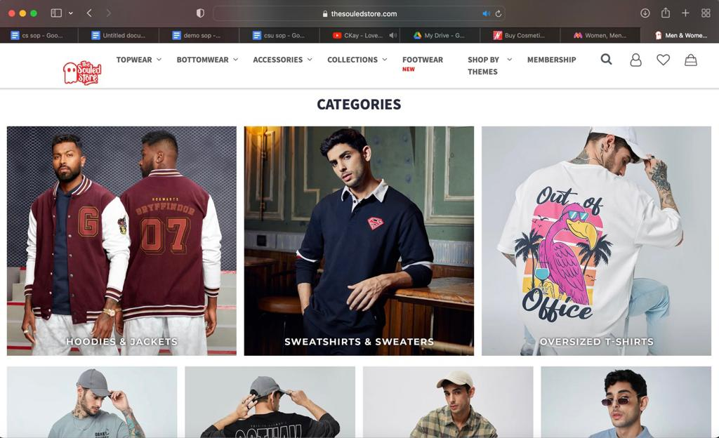
Reference Website : Souled Store User can easily find categories of clothes they like. This will increase the user engagement in our website.

Slide 11
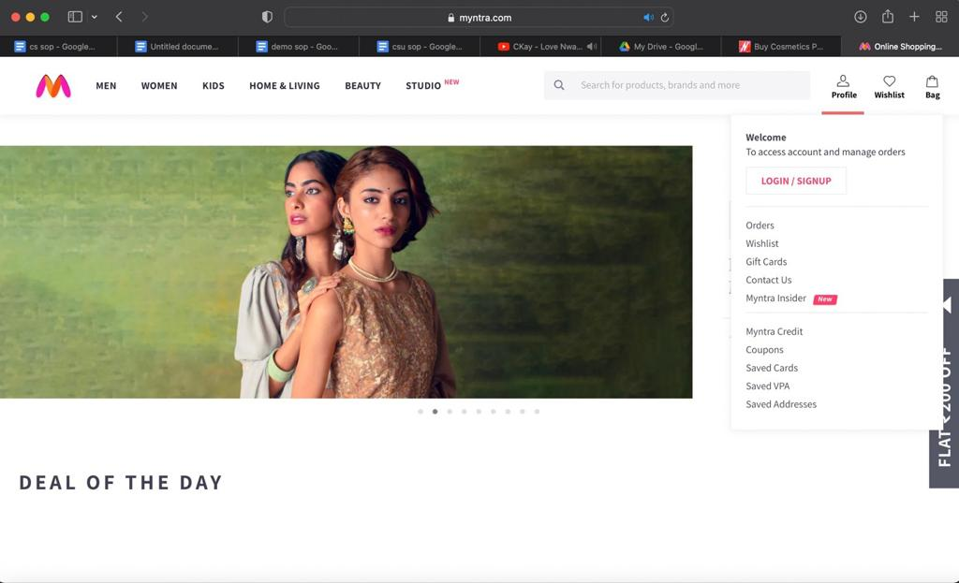
Reference Website : Myntra User can easily add their choices to the wishlist and can order later. Can access different deals of the day. Can review and rate the products which one can see before buying the product.

Slide 12
Software Requirements
Wordpress (PHP)
HTML
SQL
Web browser: Internet explorer,
Mozilla, Google chrome or later
Operating system: Windows

Slide 13
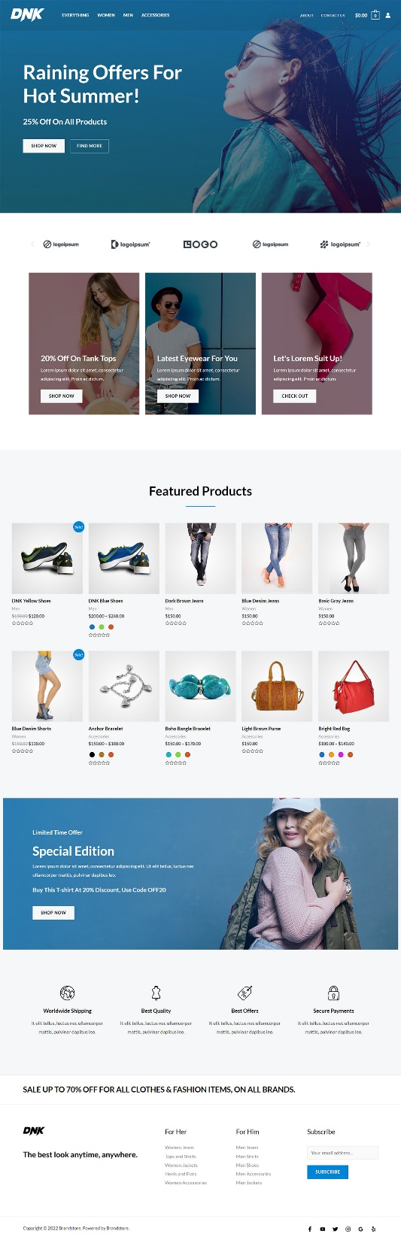
Home Page

Slide 14
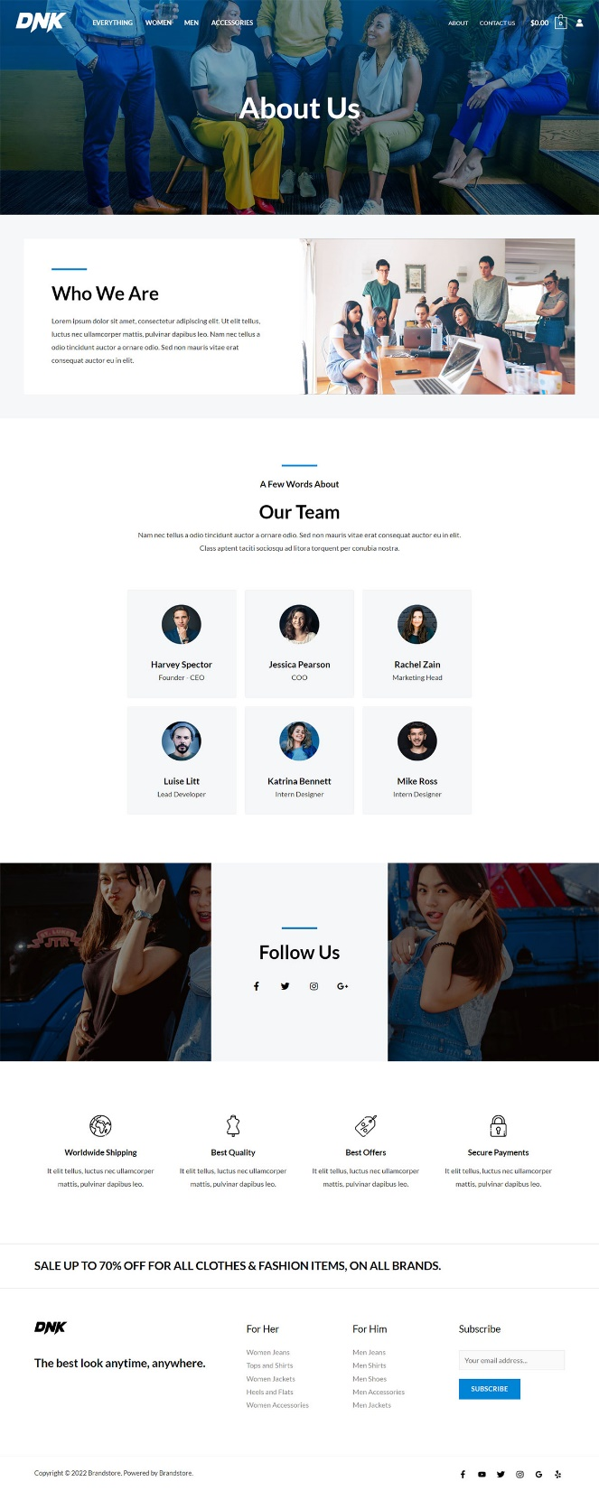
About us

Slide 15
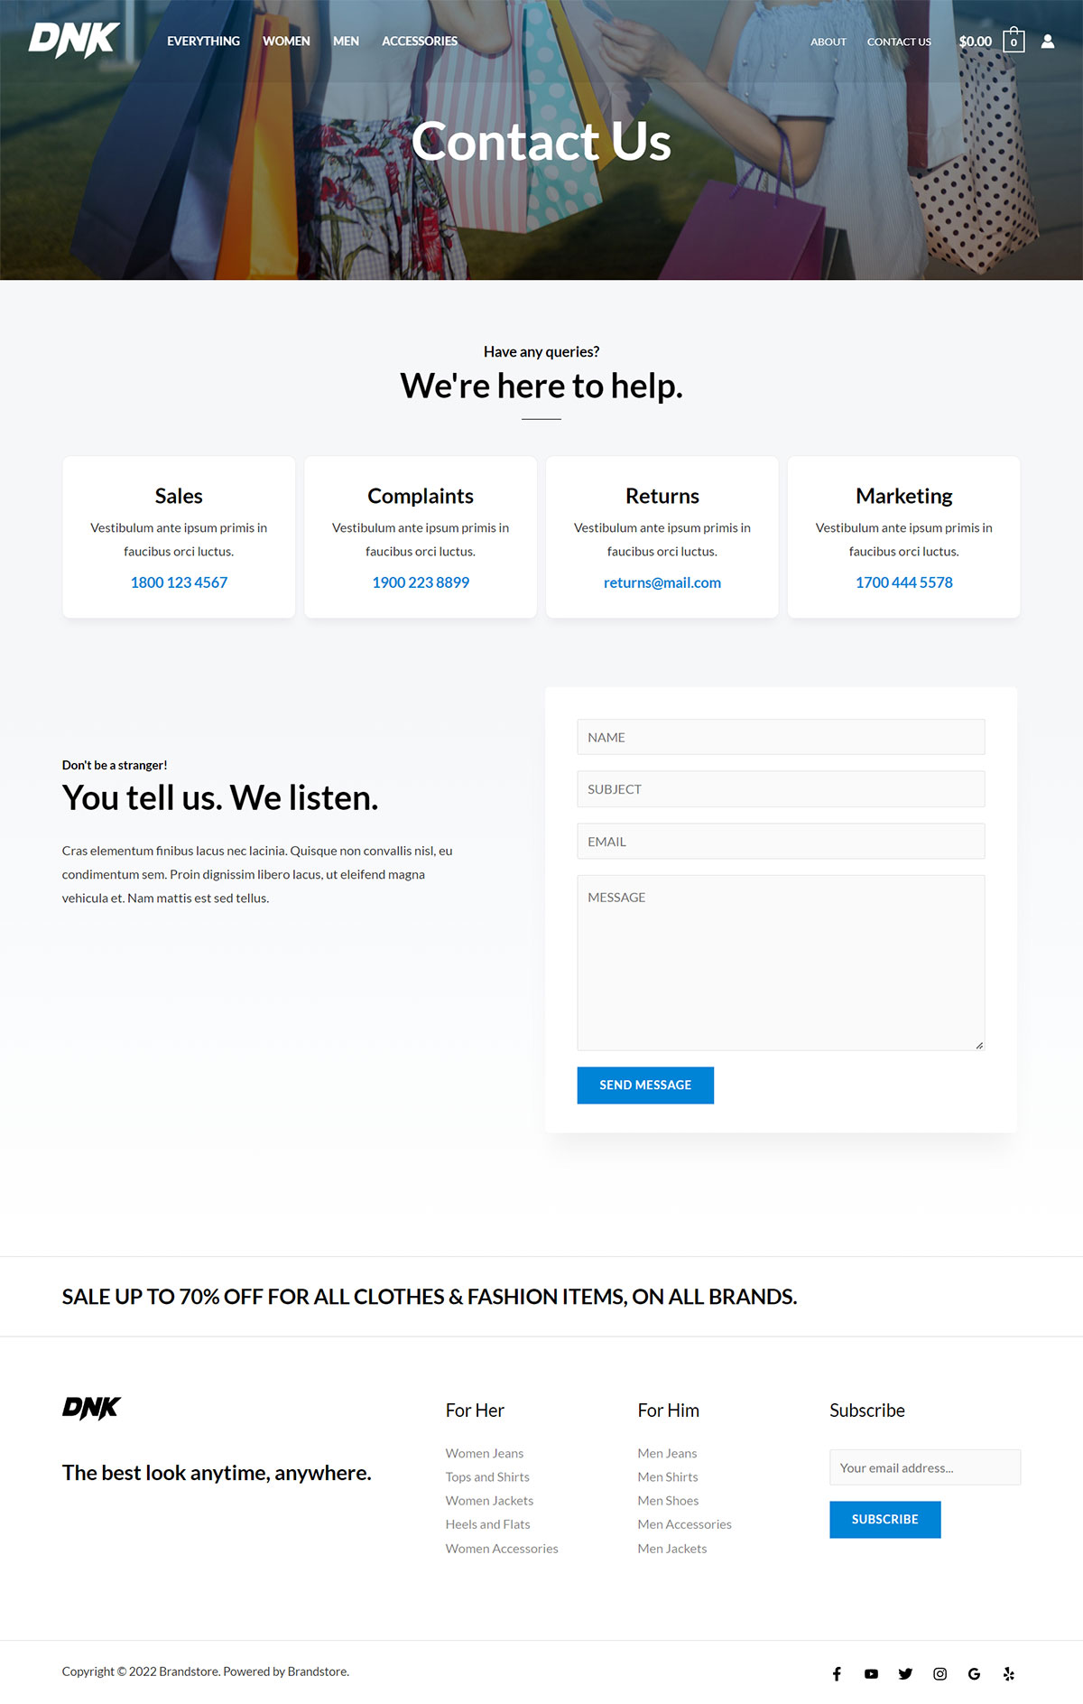
Contact us

Slide 16
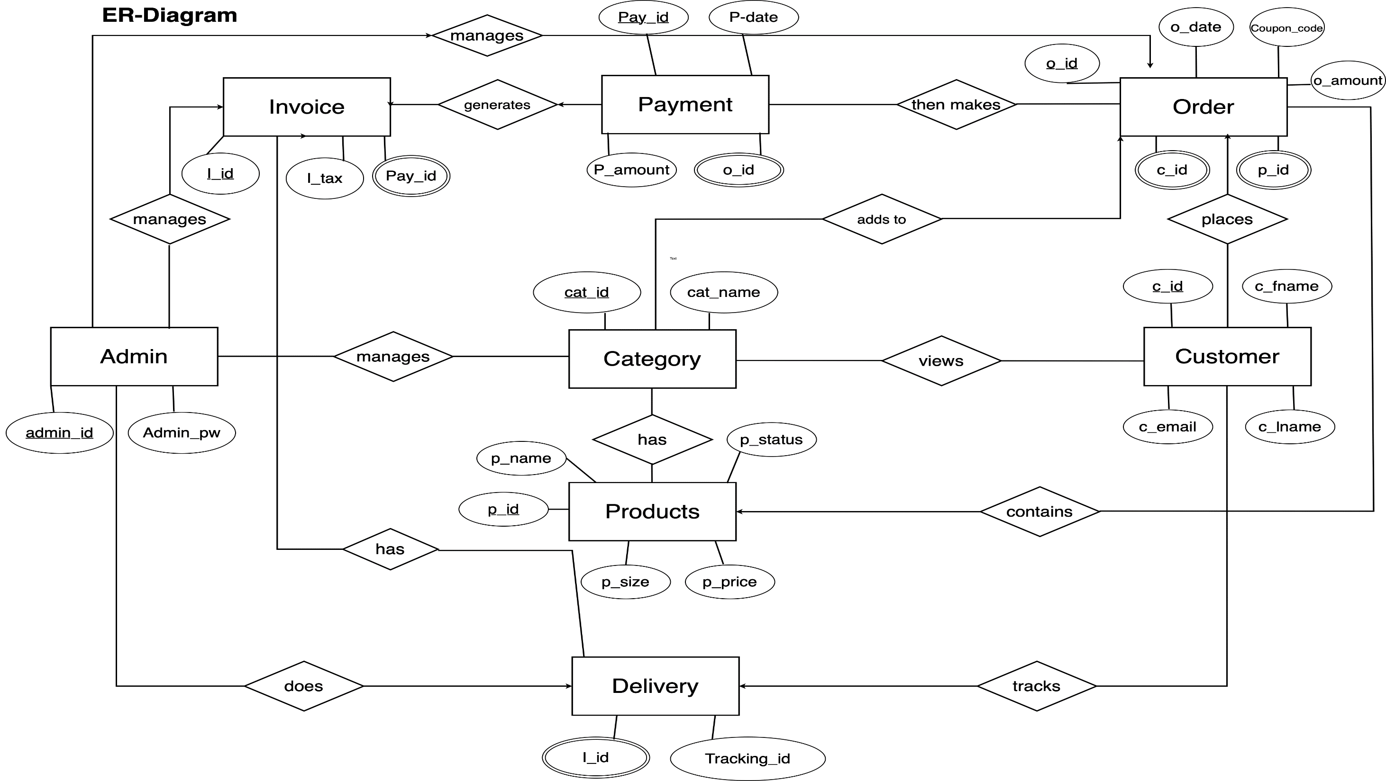

Slide 17
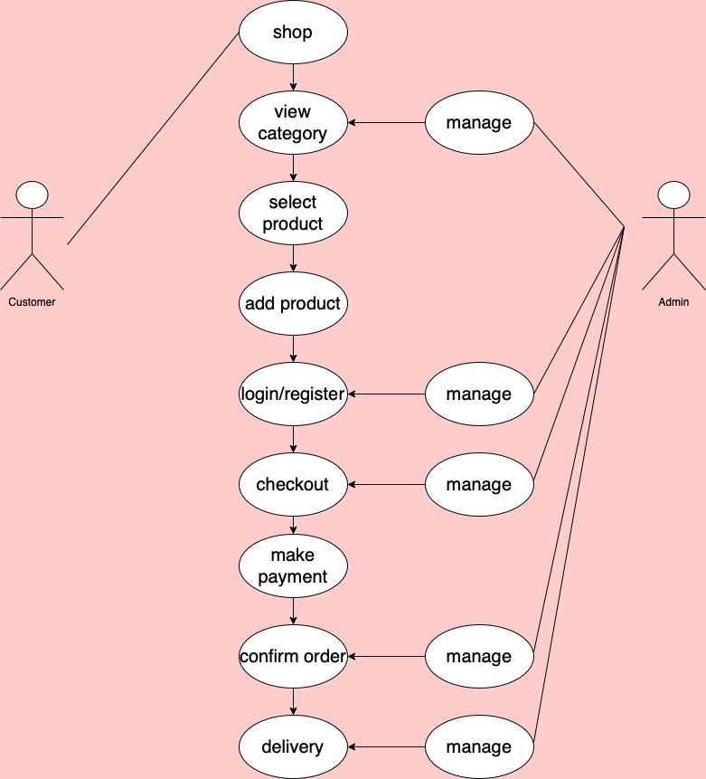

Use – Case
Diagram
Managed
by Admin

Slide 18
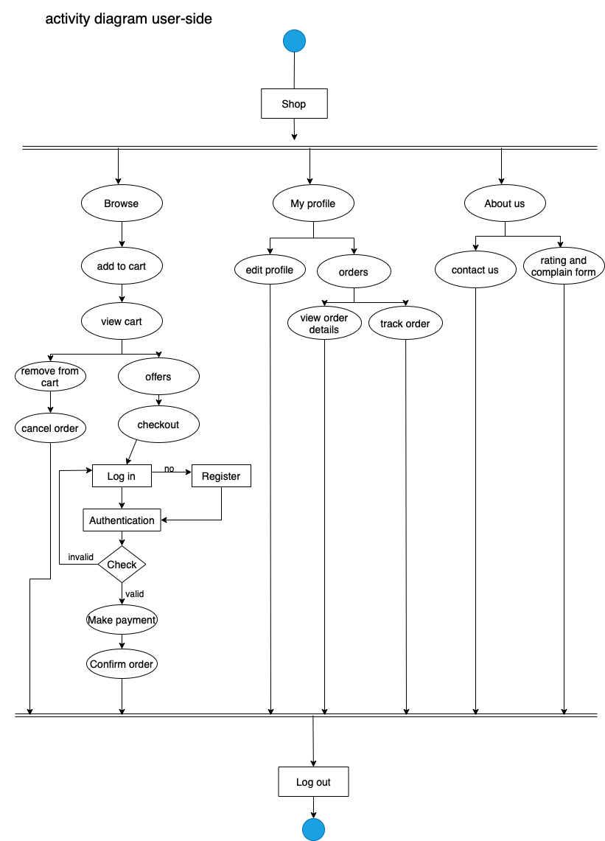
Activity Diagram
(User Side)

Slide 19
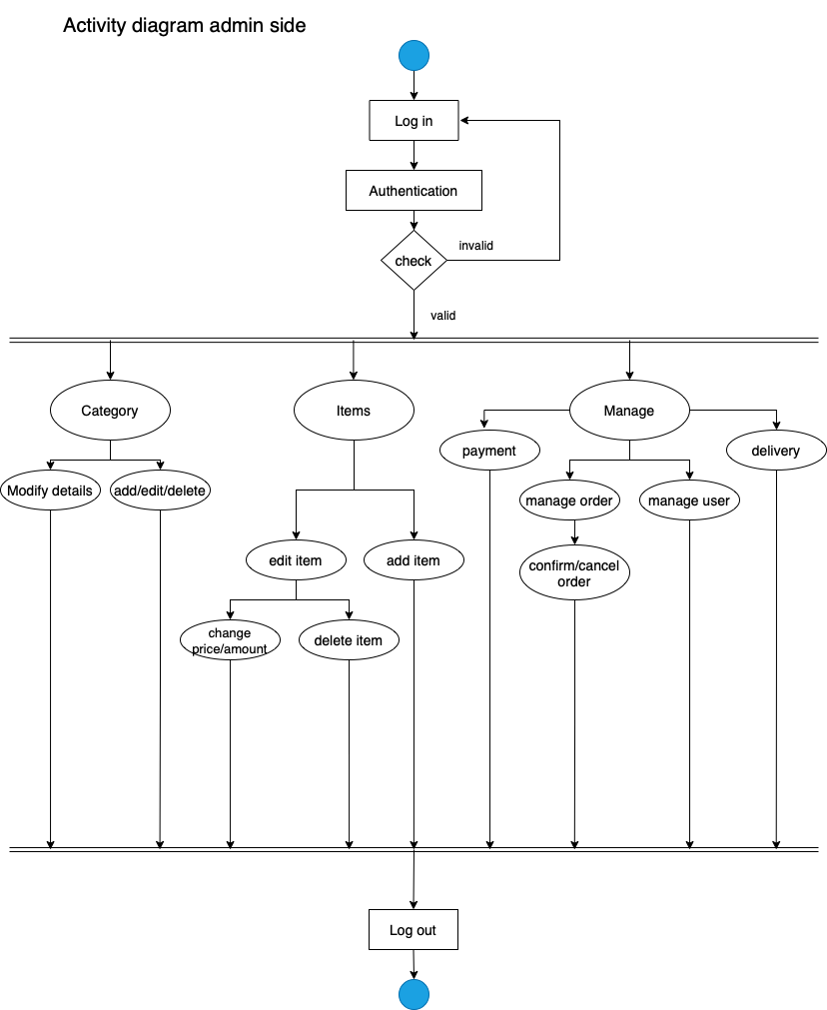
Activity Diagram
(Admin Side)

Slide 20
Data Dictionary
Customer
Column | Data Type | Constraint | Auto Increment | Description
c_id | int(10) | primary key | yes | ID for unique identification
c_fname | String(20) | not null | no | first name
c_lname | String(20) | not null | no | last name
c_email | VARCHAR(20) | not null | no | email address
Admin
Column | Data Type | Constraint | Auto Increment | Description
admin_id | int(10) | primary key |  | ID for unique identification
admin_pw | VARCHAR(20) | not null |  | password
Category
Column | Data Type | Constraint | Auto Increment | Description
cat_id | int(10) | primary key | yes | ID for unique identification
cat_name | VARCHAR(20) | not null | no | category name

Slide 21
Products
Column | Data Type | Constraint | Auto Increment | Description
p_id | int(10) | primary key | yes | ID for unique identification
p_name | VARCHAR(20) | not null | no | product name
p_size | String(10) |  |  | product size
p_status | String(10) | not null | no | product status
p_price | int(10) | not null | no | product price
Order
Column | Data Type | Constraint | Auto Increment | Description
o_id | VARCHAR(20) | primary key | yes | ID for unique identification
o_date | VARCHAR(12) | not null | no | order date
o_amount | int(10) | not null | no | order amount
c_id | int(10) | foreign key |  | FK : customer table
p_id | int(10) | foreign key |  | FK : product table
coupon_code | VARCHAR(10) |  |  | coupon code
Payment
Column | Data Type | Constraint | Auto Increment | Description
pay_id | VARCHAR(15) | primary key | yes | ID for unique identification
p_date | VARCHAR(15) | not null | no | payment date
p_amount | int(10) | not null | no | payment amount
o_id | VARCHAR(20) | foreign key |  | FK : order table

Slide 22
Invoice
Column | Data Type | Constraint | Auto Increment | Description
I_id | VARCHAR(20) | primary key | yes | ID for unique identification
I_tax | VARCHAR(20) | not null | no | invoice tax
pay_id | VARCHAR(15) | foreign key |  | FK : payment table
Delivery
Column | Data Type | Constraint | Auto Increment | Description
Tracking_id | VARCHAR(20) | primary key | yes | ID for unique identification
I_id | VARCHAR(20) | foreign key |  | FK : invoice table

Slide 23
Snapshots

Slide 24

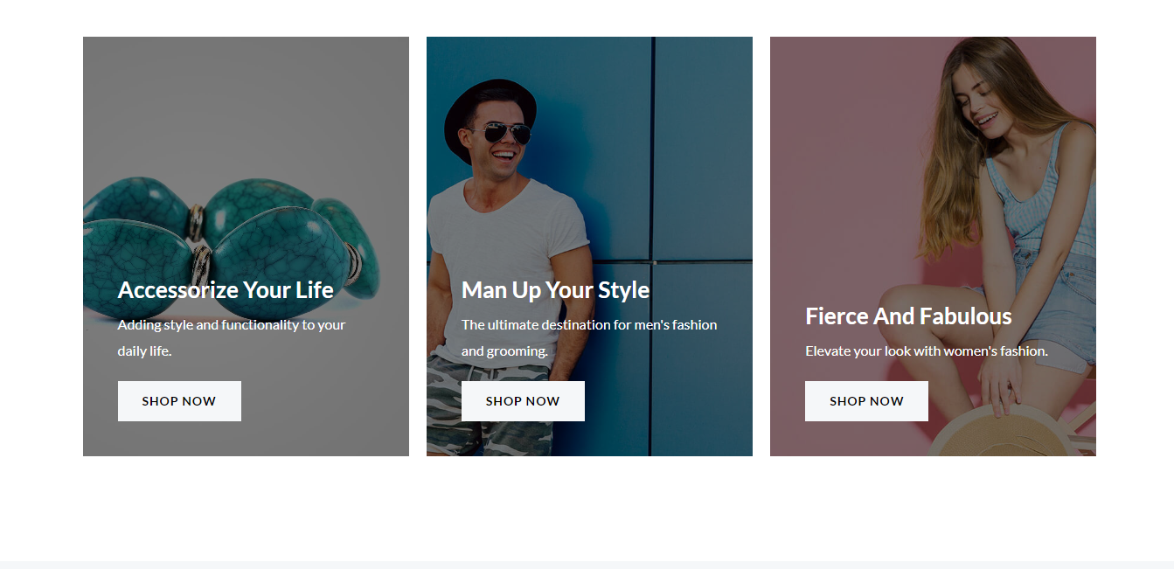
1) Home Page

Slide 25
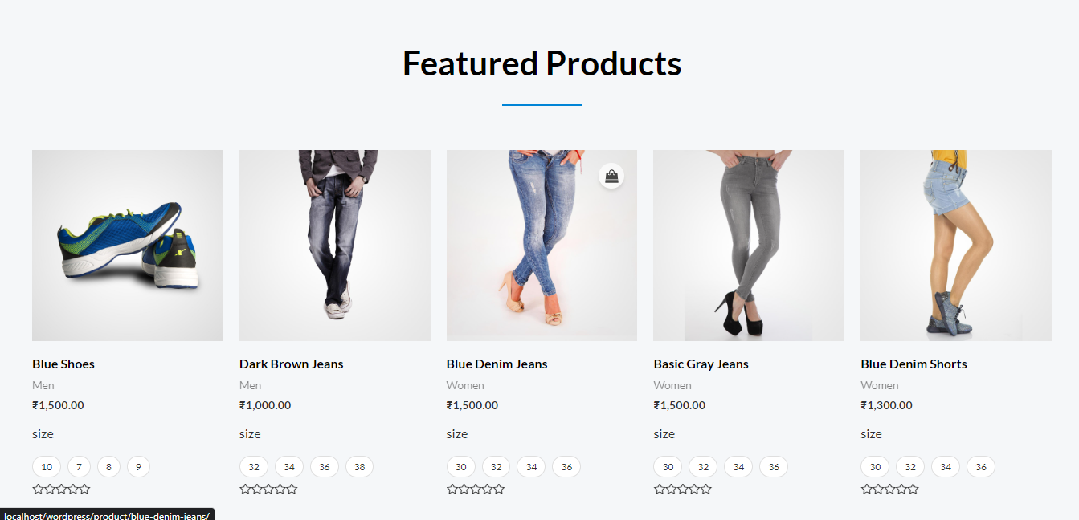
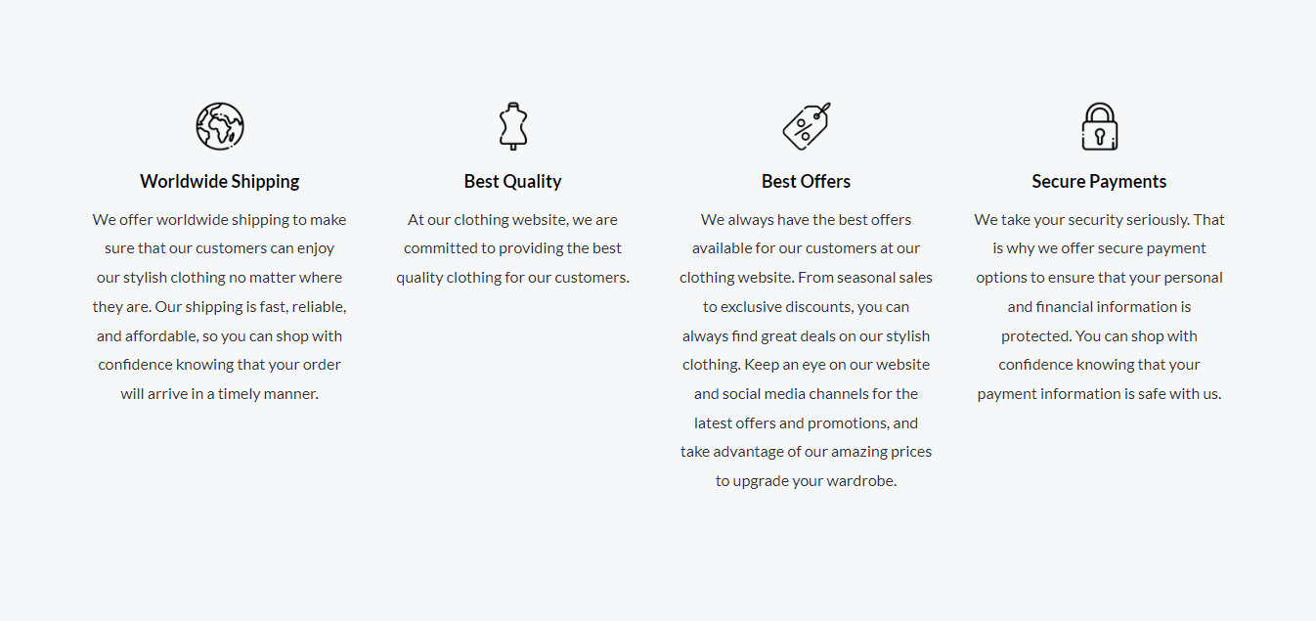

Slide 26

2) Shop Categories

Slide 27
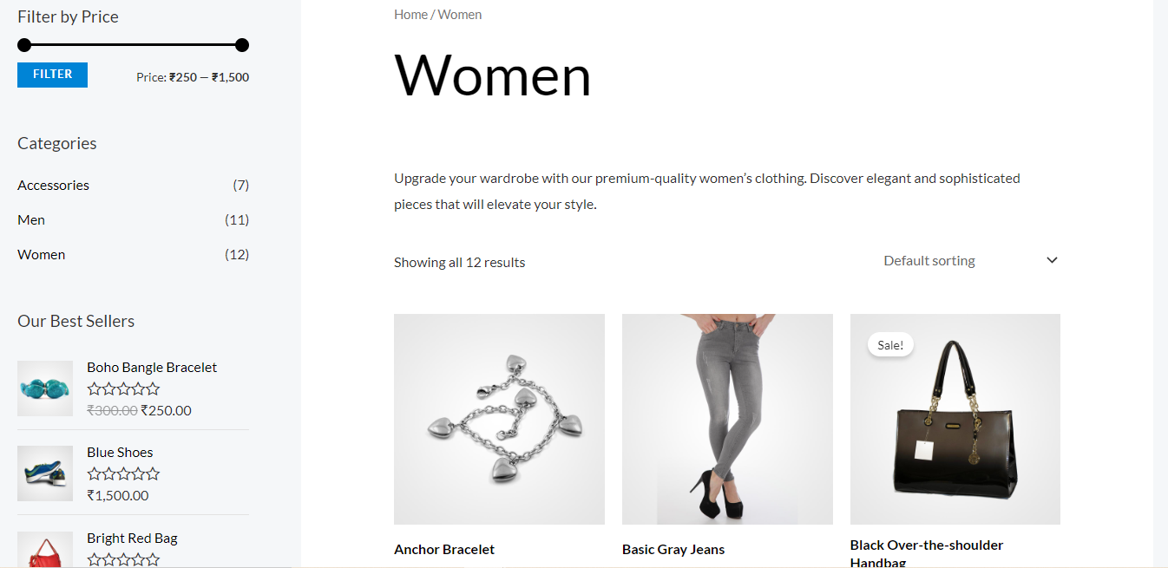
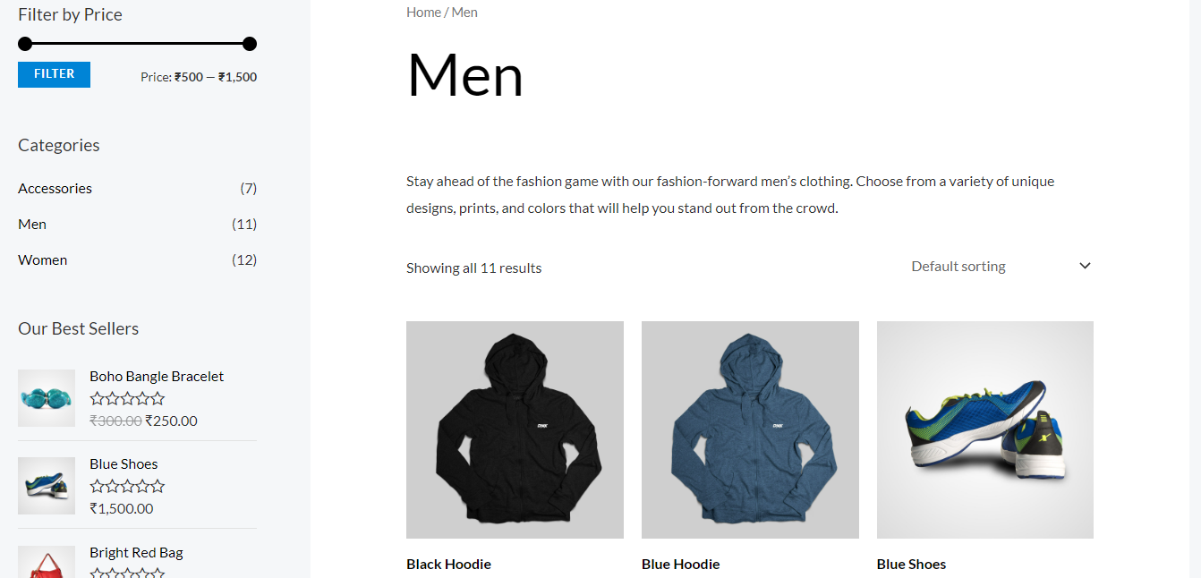
2.1) Women Category
2.2) Men Category

Slide 28
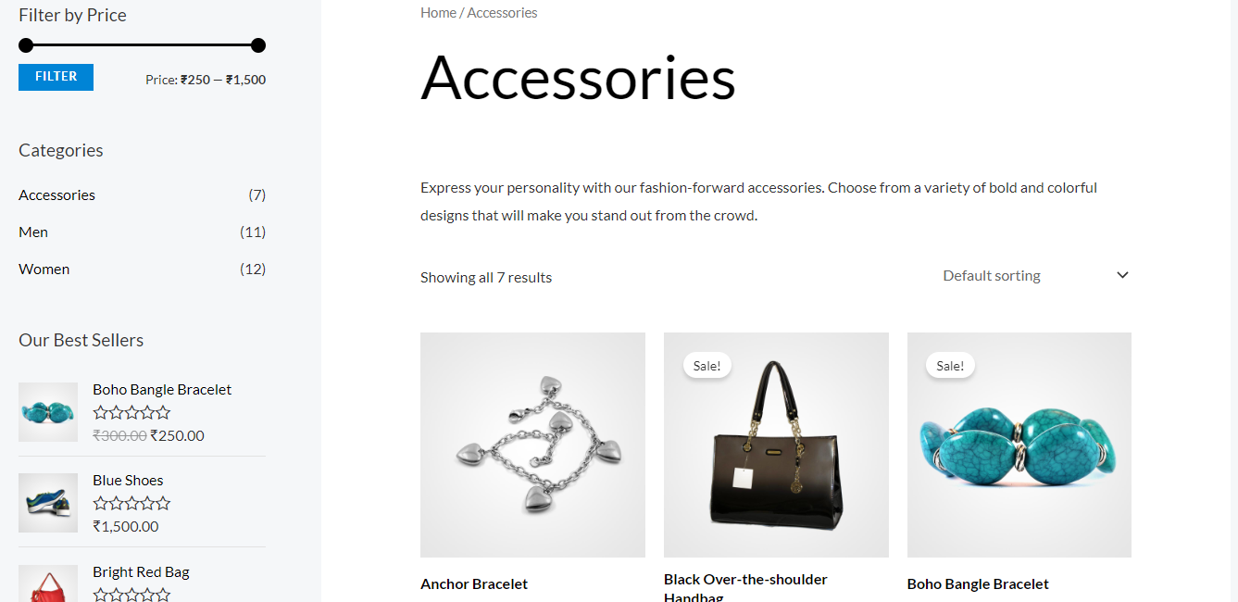
2.3) Accessories Category

Slide 29
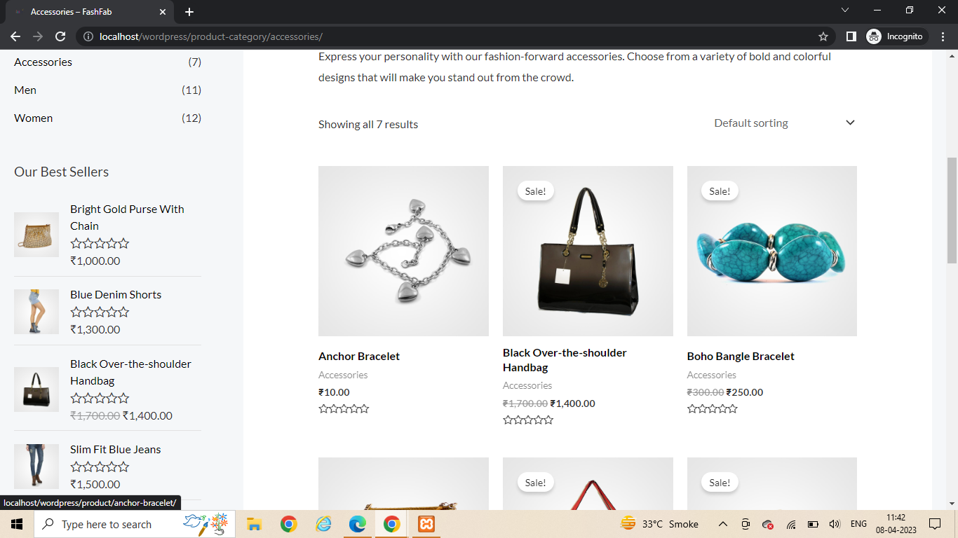
3) View and select product

Slide 30
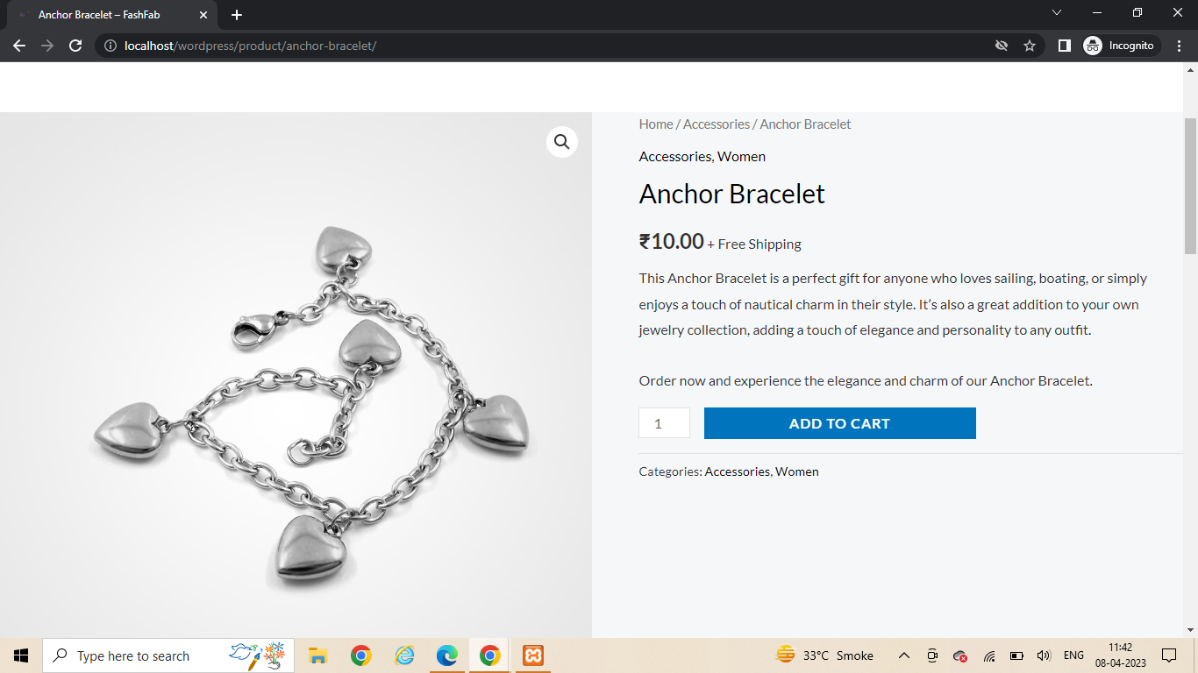
4) Add to cart

Slide 31
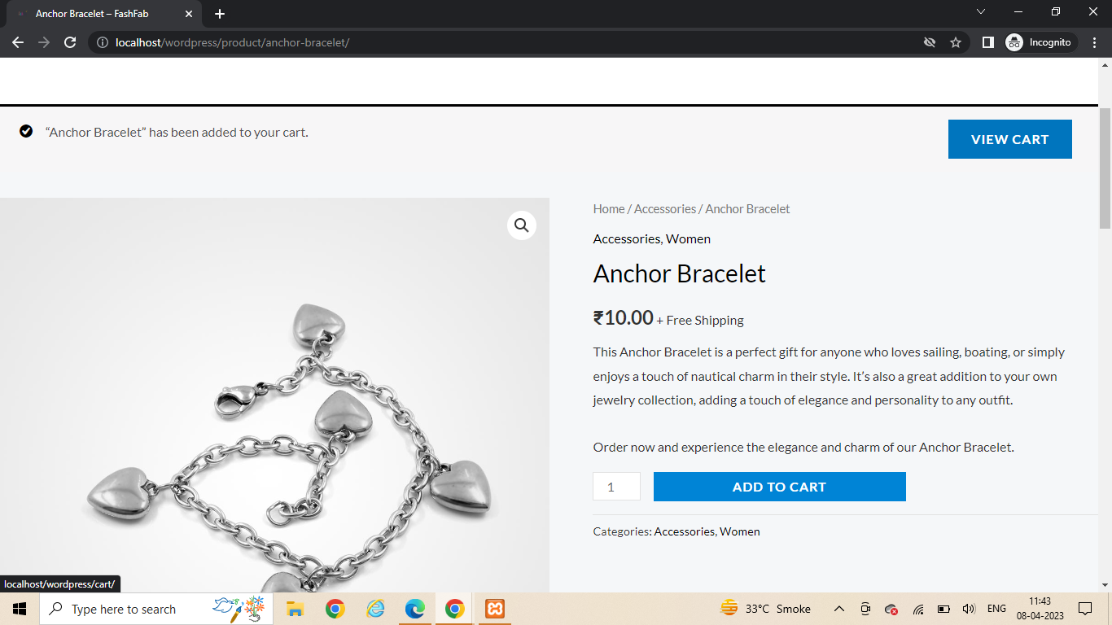
5) view cart

Slide 32
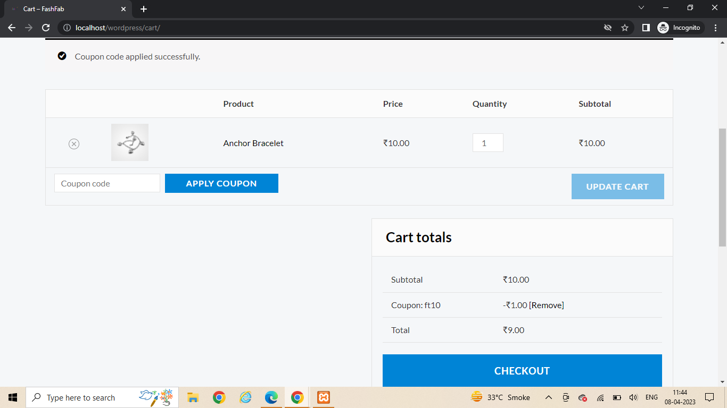
5) Apply coupon code and proceed to checkout

Slide 33
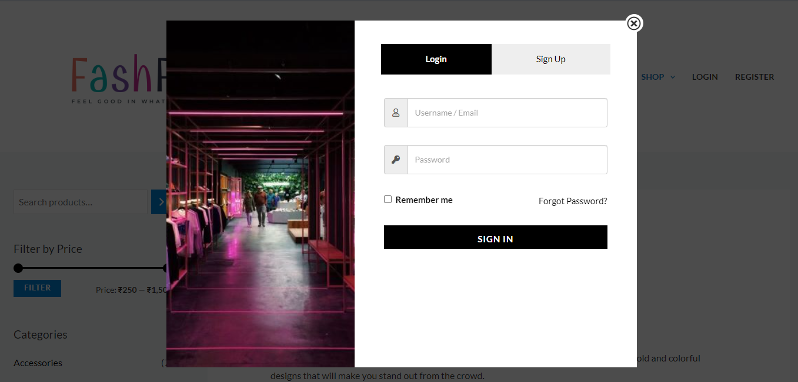
6) IF EXIXTING USER LOG-IN

Slide 34
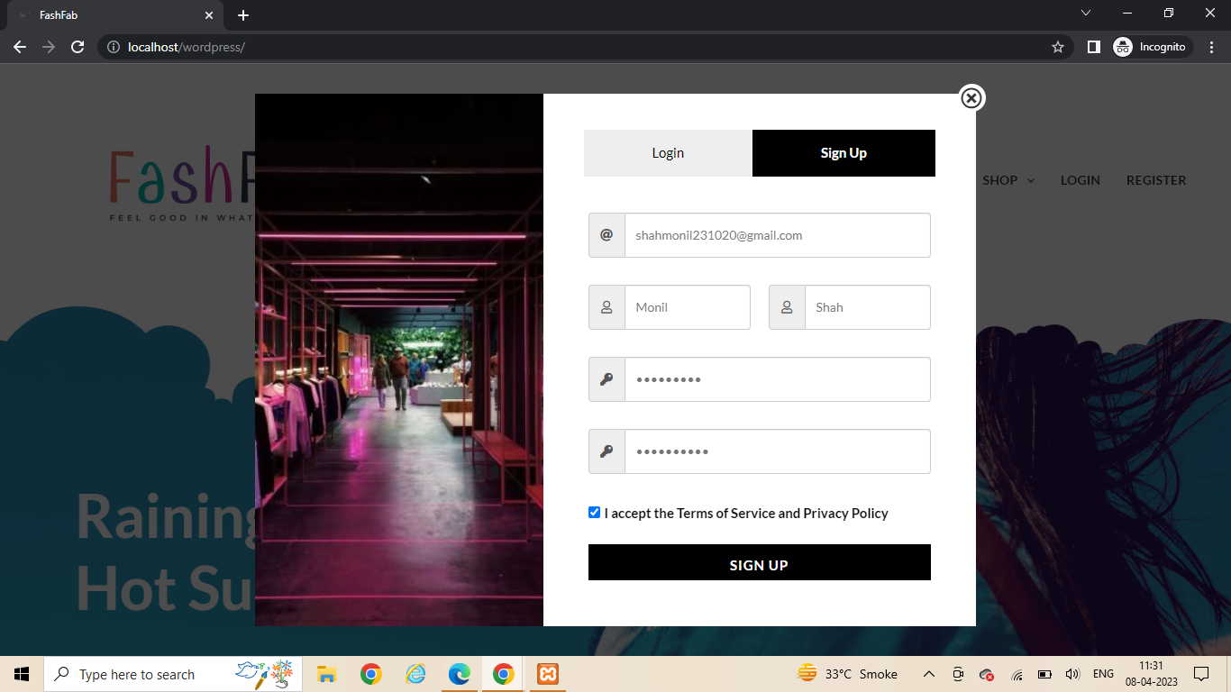
7) IF NEW USER SIGNUP

Slide 35
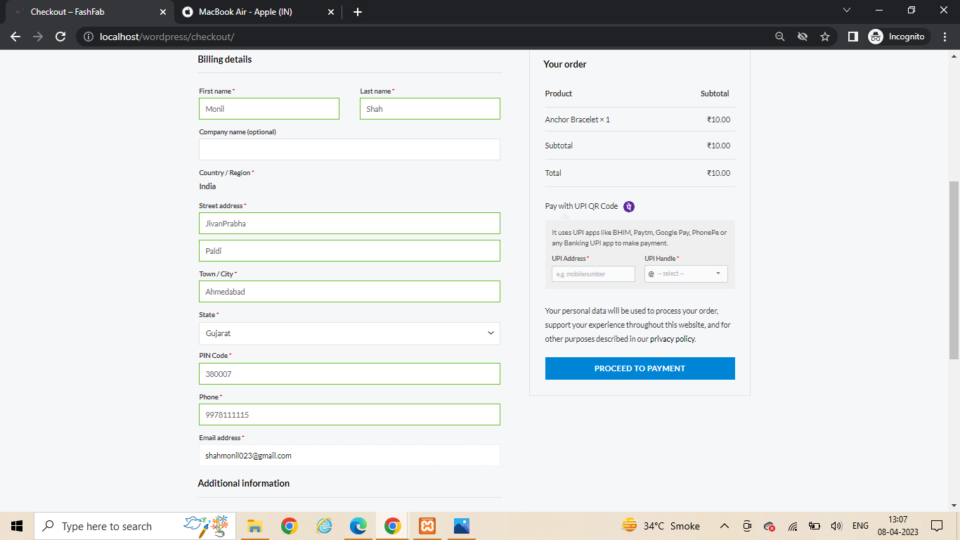
8) FILL BILLING DETAILS FORM

Slide 36
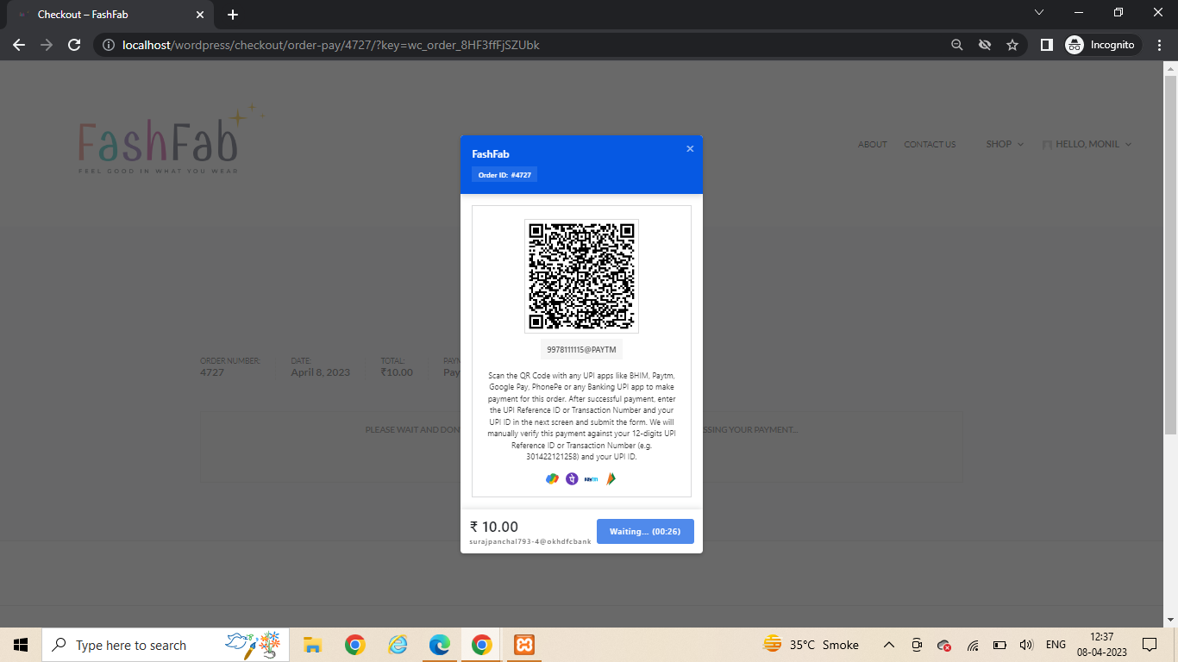
9) SCAN QR CODE

Slide 37
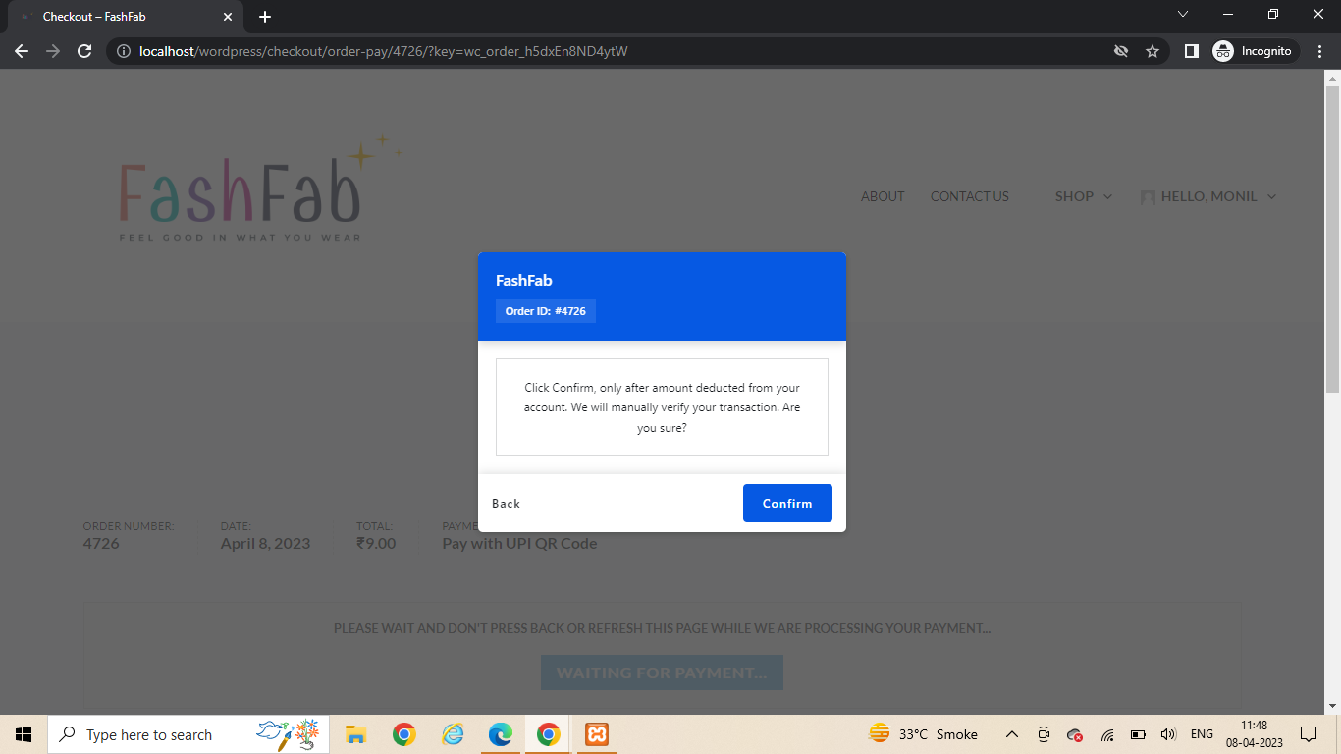
10) CONFIRM ORDER

Slide 38
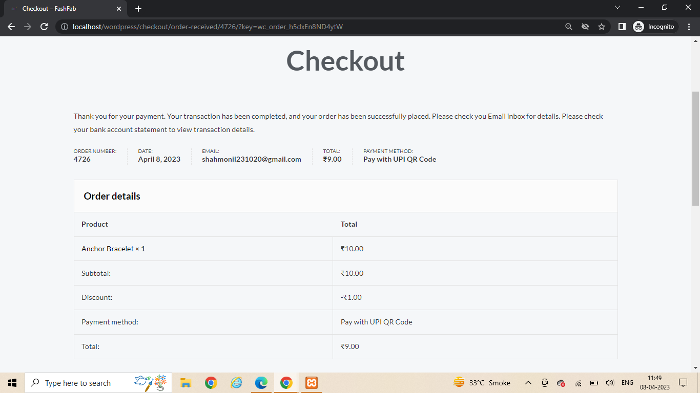
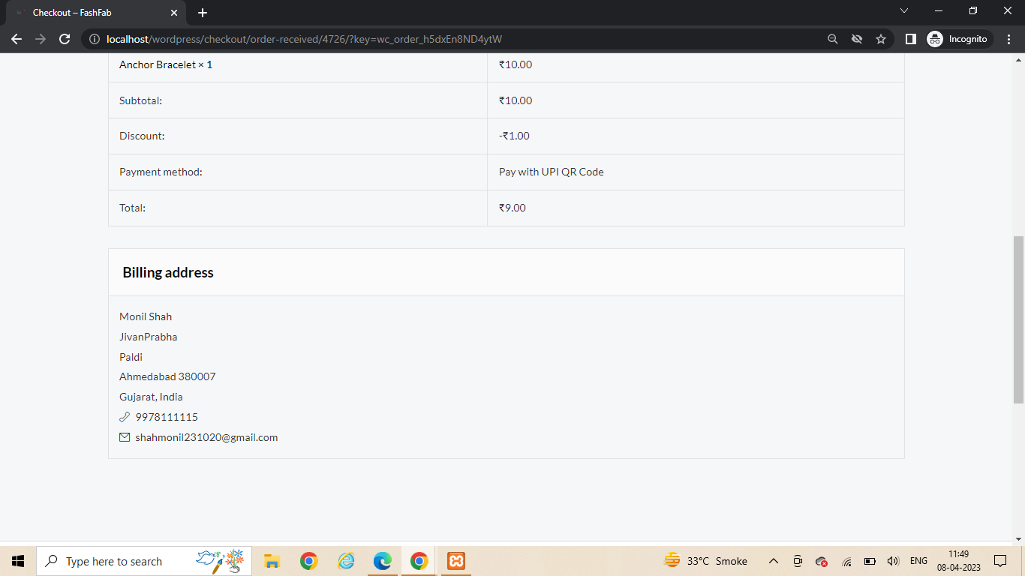
11) GENERATED ORDER BILL

Slide 39
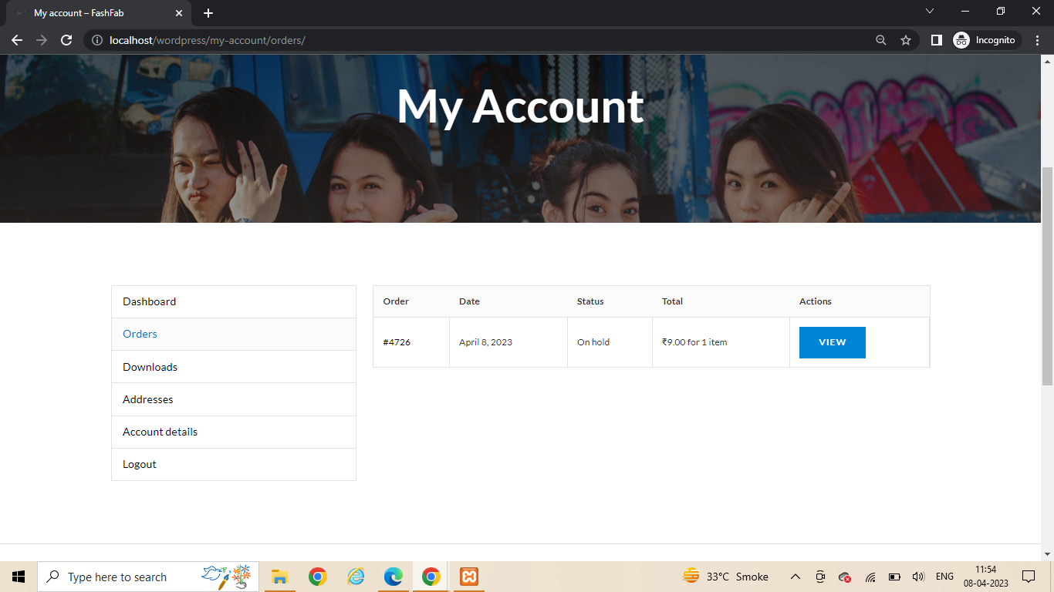
12) MY ACCOUNT > VIEW ORDERS

Slide 40
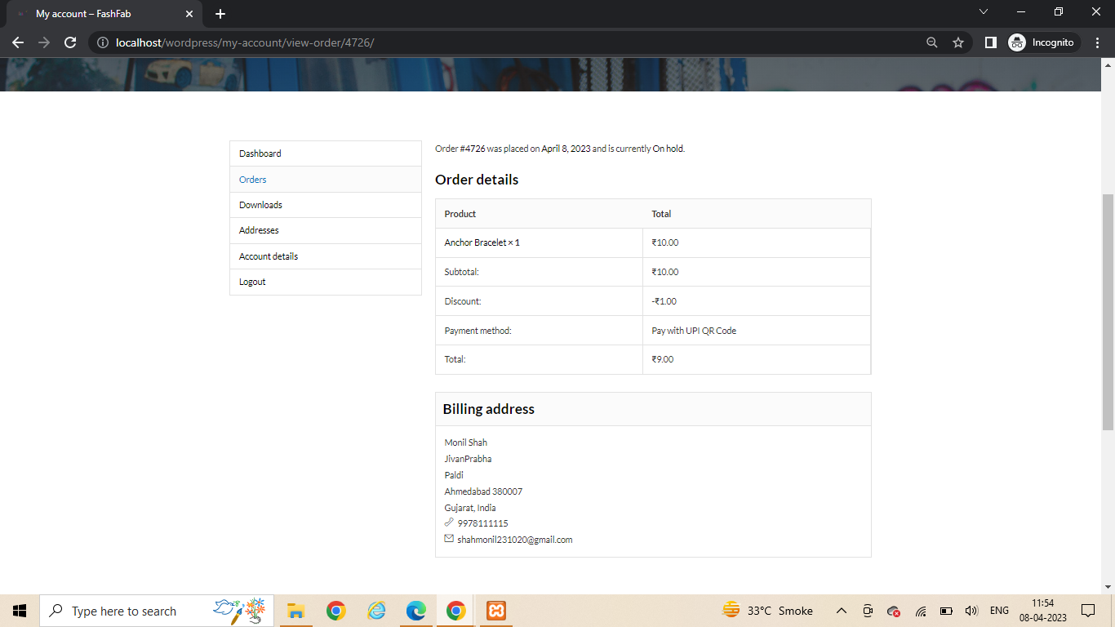
13) ORDER DETAILS

Slide 41
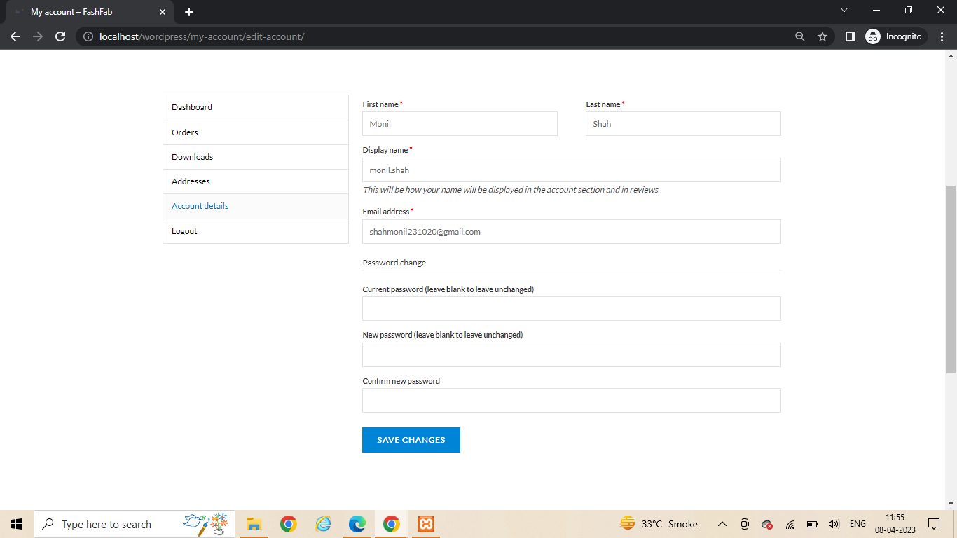
13) MY ACCOUNT > ACCOUNT DETAILS

Slide 42

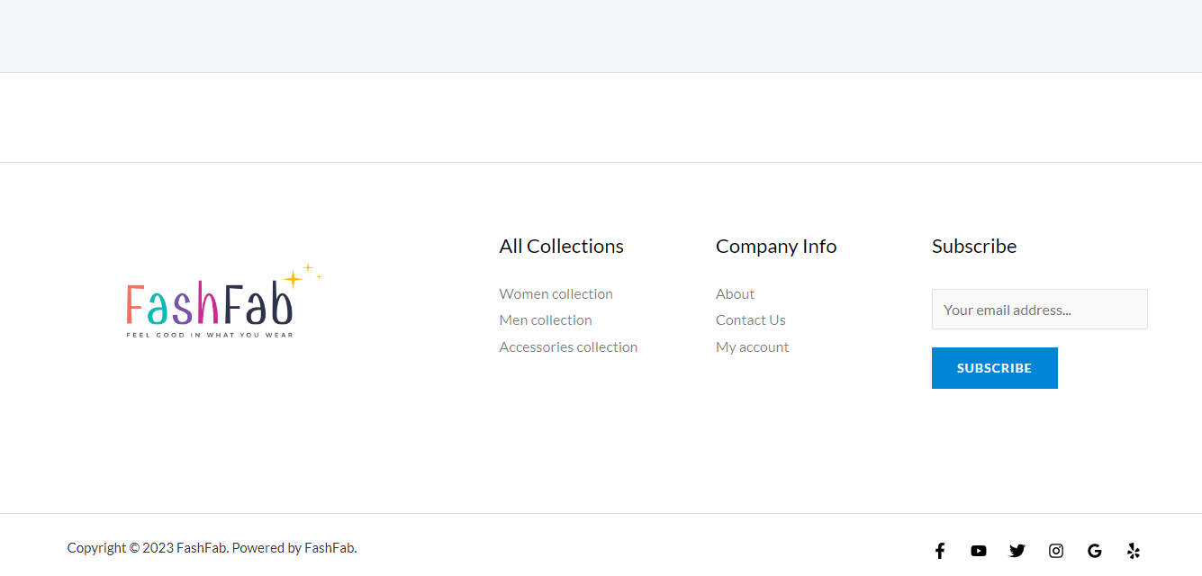
14) ABOUT US PAGE

Slide 43
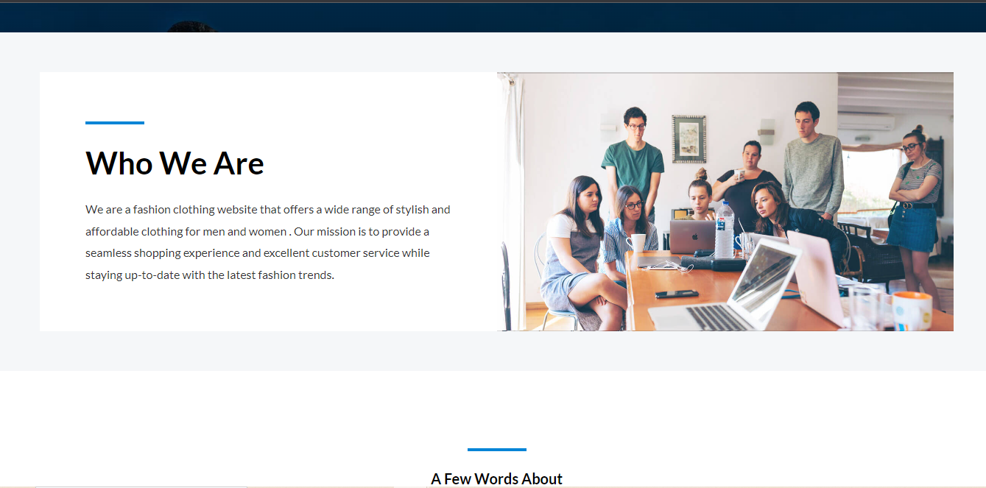
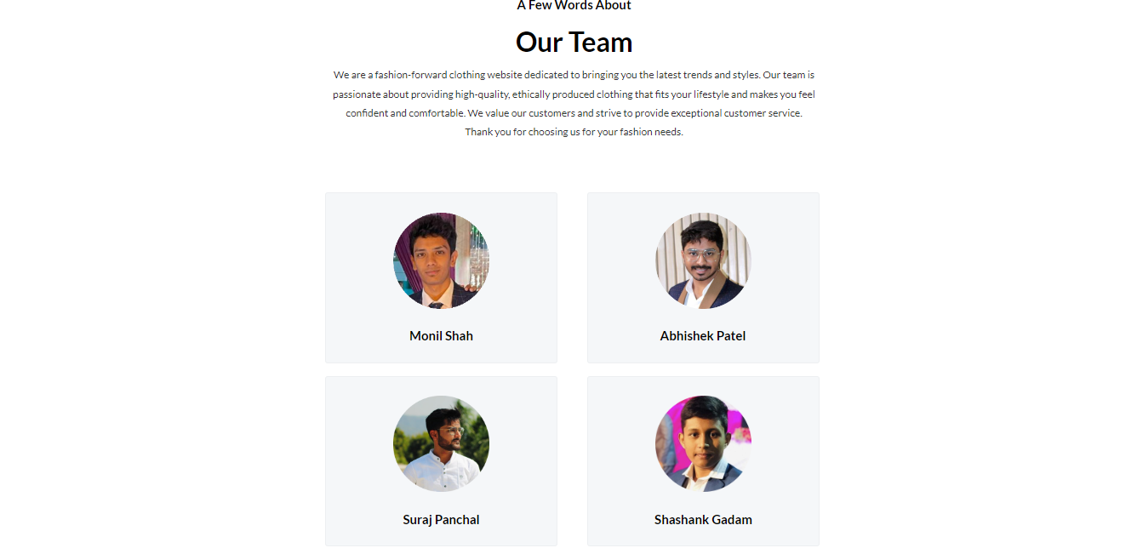

Slide 44

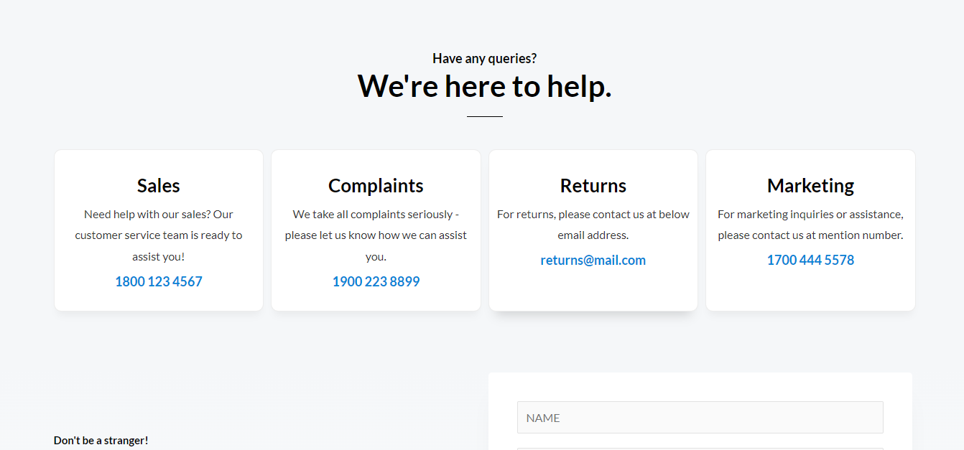
15) CONTACT US PAGE

Slide 45
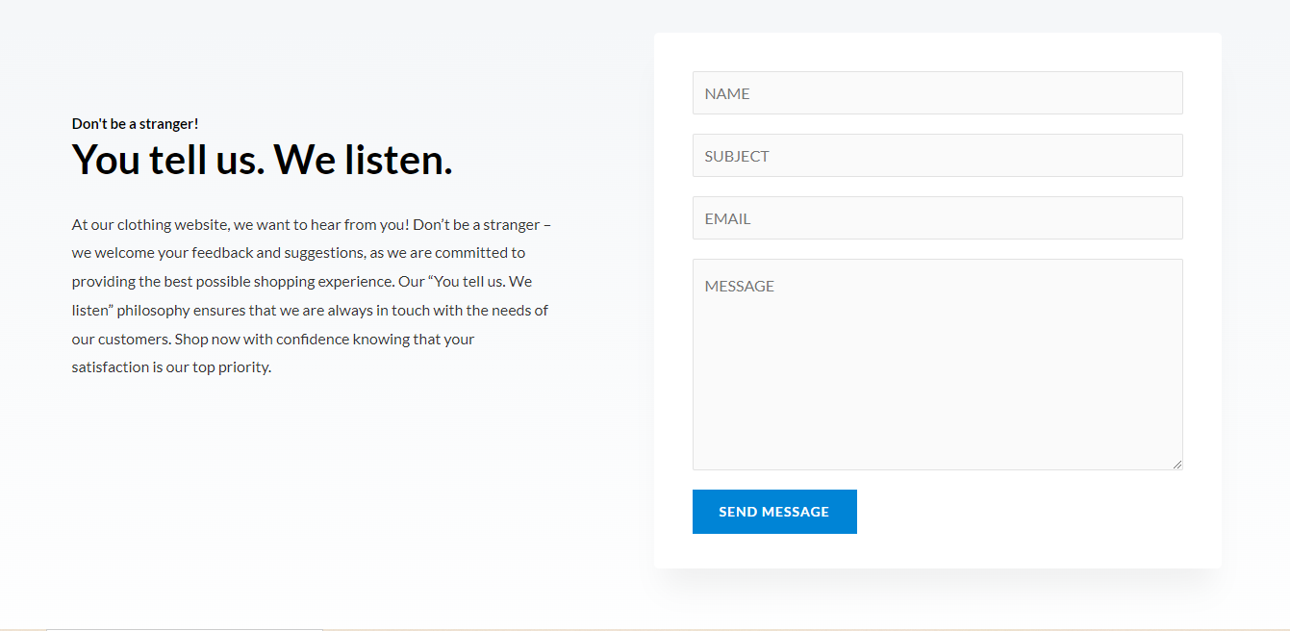
16) REVIEW AND FEEDBACK FORM

Slide 46
THANK YOU

